Slide 1
SkillsUSA: Web Design
Lesson 2: Advanced HTML and CSS Integration

Slide 2
Warm-up
Using only HTML 5, create the following pages:
“Overview of the Noble Gases”
Should contain an ordered list with the name of each noble gas, followed by the atomic mass and the atomic number.
e.g., <GAS NAME> : <ATOMIC MASS> : <ATOMIC NUMBER>
Each ordered list item should contain a sub list (unordered) with some properties of each gas
Each ordered list item (the name of the gas) should be linked to the Wikipedia page for that gas
“My Favorite Element”
Should contain a header of the appropriate size with the name of your favorite atomic element, linked to the Wikipedia article for that element.
A paragraph explaining why it is your favorite element
An image of the element
A form, set within a fieldset and given a legend, which allows users to submit their favorite element and requires the following fields:
Name
Email
Element Name
Description (hint: use a <textarea>)
The form does not need to submit anywhere, so no action attribute is required.

Slide 3
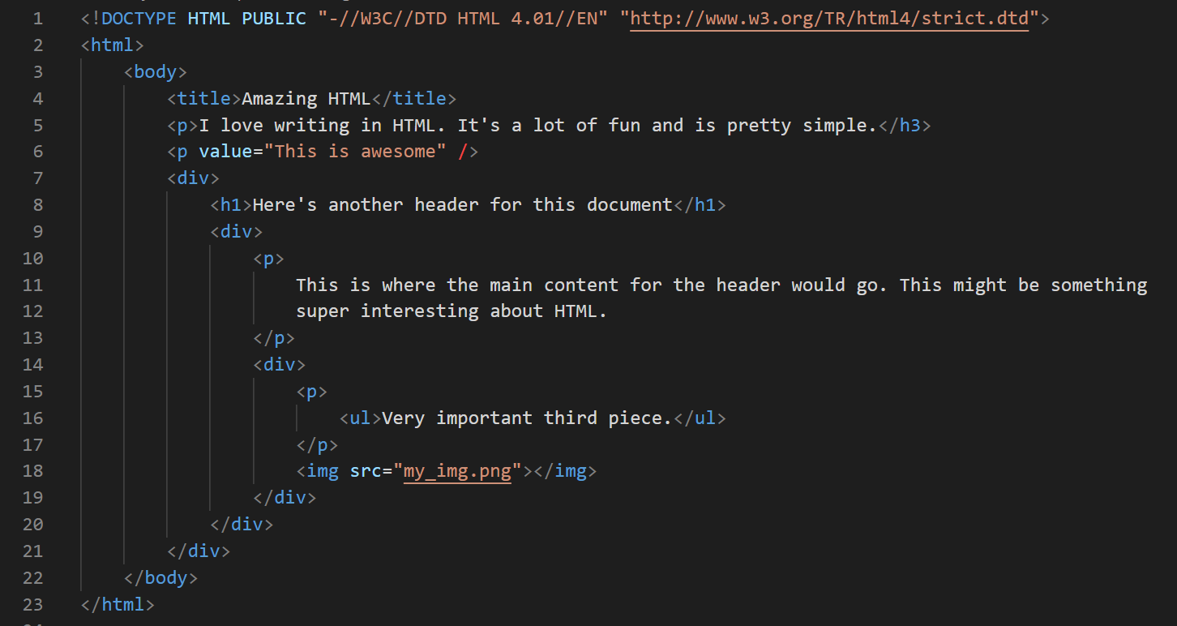
What’s wrong with this code?

Slide 4
Quick HTML Review!
What language was the precursor to HTML?
SGML – Standard Generalized Markup Language
HTML 5 documents should always begin with what?
<!DOCTYPE html> a.k.a. the Doctype Declaration
True or False – HTML 5 documents should always include a DTD
False. HTML 5 does not use a DTD.
What is the “Separation of Concerns?”
A design philosophy centered around the idea that content, design, and behavior should be distinct, separate goals.

Slide 5

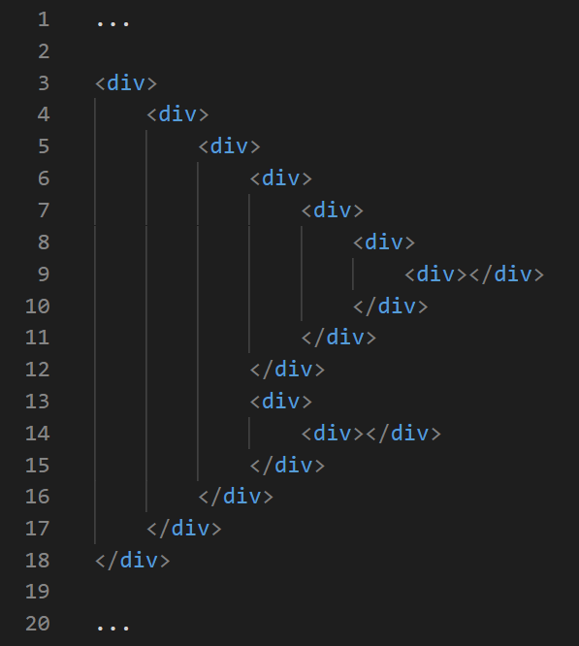
HTML Semantic Tags – Different, But Really the Same
<div> nesting nightmare.

Slide 6
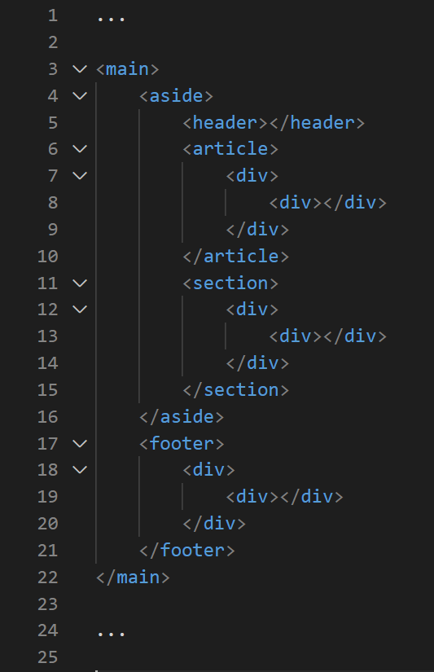
HTML Semantic Tags – Different, But Really the Same
Much easier to read, and easily navigable.

Slide 7
Common Semantic Tags
<main>
Surround the primary content of a page, excluding banners, headers, footers, and other non-core content
<article>
Use this to denote large blocks of text content (like an article in a paper)
<aside>
Use this to denote a sidebar or other non-primary (but associated) content
<header> / <footer>
Use these to denote region headers and footers
<nav>
Use to denote region navigation
<section>
Use to denote an important sectional grouping

Slide 8
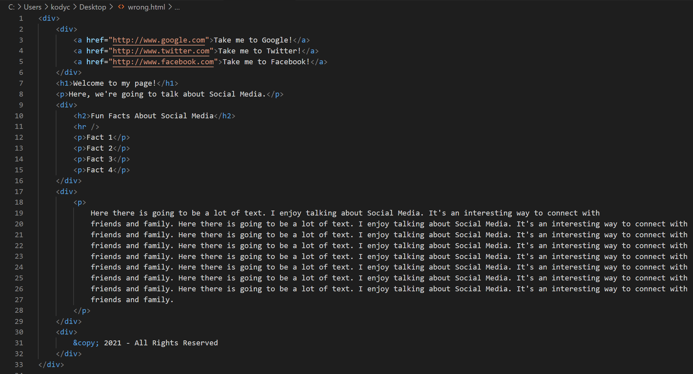
Practice with Semantic Tags

Slide 9
Lecture

Slide 10
Today’s Project
Develop an HTML page about a personal, favorite topic. Include the following HTML / CSS Components:
At least 1 table with 3 columns, one of which must span either horizontally or vertically
A page background
A non-standard font size
At least one span with modified text styling
An example of inline, embedded, and external CSS
At least one example of a descendant selector, neighbor selector, and direct descendant selector
At least one image with a custom height, width, border, and background shadow
At least two links

